Slide 1
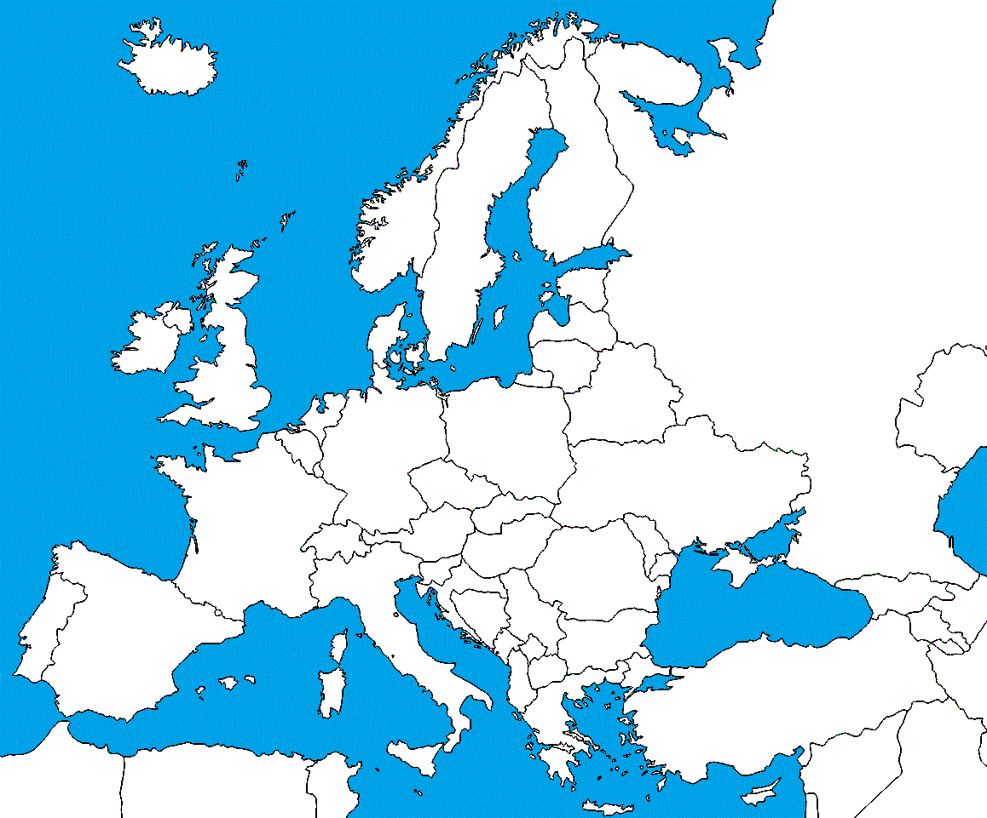

Slide 2
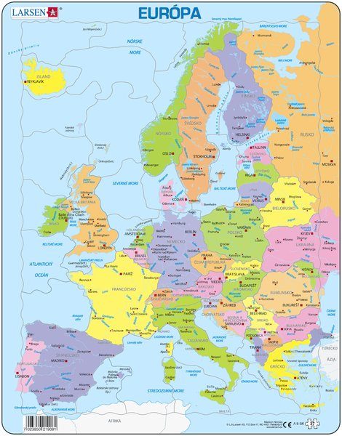

Slide 3
https://www.youtube.com/watch?v=vQhqikWnQCU
https://www.youtube.com/watch?v=bb4zvZdrMz4
https://www.youtube.com/watch?v=dGagp49q7uA
https://www.youtube.com/watch?v=hgitRq_0410
https://www.youtube.com/watch?v=0zS1kSPW2nA

Slide 4
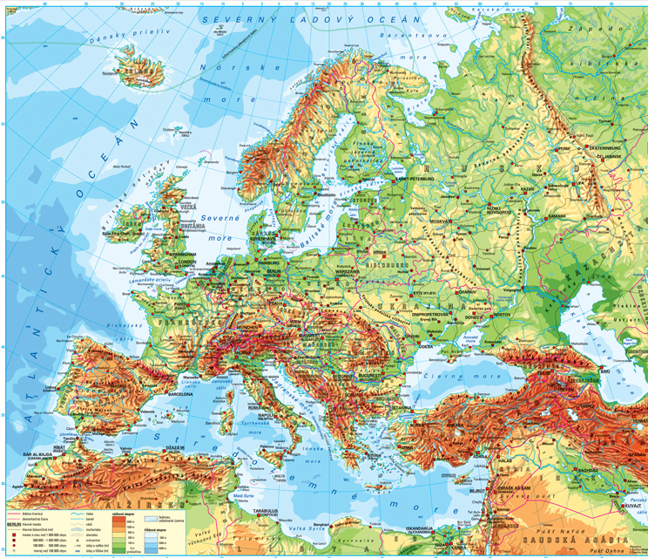

Slide 6


Slide 7


Slide 8
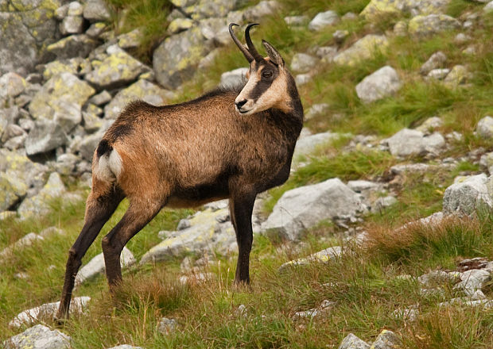

Slide 9



